Slide 1
Chapter 2 The PIC18 Assembly Language Programming

Slide 2
Sections
2.1 Inside the PIC18
2.2 Simple PIC18 Program
2.3 Introduction to PIC18 Assembly Programming
2.4 Assembling and Running an PIC18 Program
2.5 The Program Counter and ROM Space in the PIC18
2.6 RISC Architecture in the PIC
2.7 PIC18 Flag Bits and the PSW Register
2.8 PIC18 Register Banks and Stack

Slide 3
Sections
2.1 Inside the PIC18
2.2 Simple PIC18 Program
2.3 Introduction to PIC18 Assembly Programming
2.4 Assembling and Running an PIC18 Program
2.5 The Program Counter and ROM Space in the PIC18
2.6 RISC Architecture in the PIC
2.7 PIC18 Flag Bits and the PSW Register
2.8 PIC18 Register Banks and Stack

Slide 4
Review: PIC18 Architecture
Harvard Architecture which includes:
Microprocessor unit (MPU)
Program memory for instructions
Data memory for data
I/O ports
Support devices such as timers

Slide 5
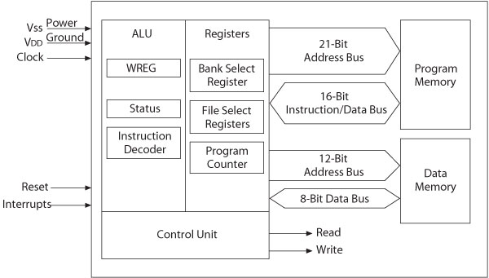
Review: MPU and Memory

Slide 6
PIC18 Memory Organization
Program Memory
21-bit address bus
Address up to 2²¹=2M bytes of memory
Not all memory locations are implemented
16-bit data bus
Data Memory
12-bit address bus (4k bytes memory space)
8-bit data bus

Slide 7
Microprocessor Unit
Includes Arithmetic Logic Unit (ALU), Registers, and Control Unit
Arithmetic Logic Unit (ALU)
Instruction decoder
16-bit instructions
Status register
5-bits (5 flags)
WREG – working register
accumulator (8-bit)

Slide 8
Microprocessor Unit
Registers
Program Counter (PC)
21-bit
Bank Select Register (BSR)
4-bit register used in direct addressing the data memory (16 banks)
File Select Registers (FSRs)
12-bit registers used as memory pointers in indirect addressing data memory
Control unit
Provides timing and control signals to various Read and Write operations

Slide 9
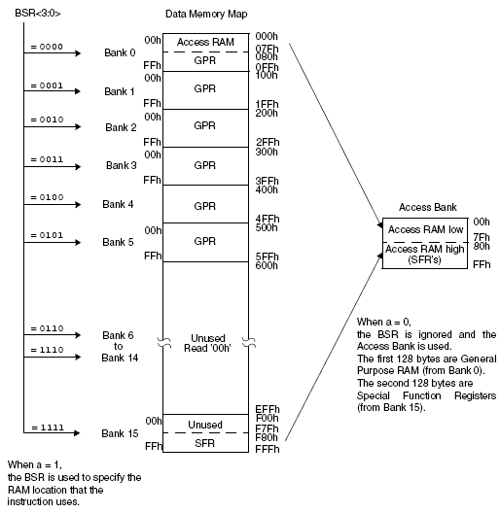
Data Memory in PIC18F452
Implemented as static RAM
12-bit (Max: 2¹²=4096 bytes)
PIC18F4520 has
128 bytes of SFRs
1536 bytes of GPRs

Slide 10
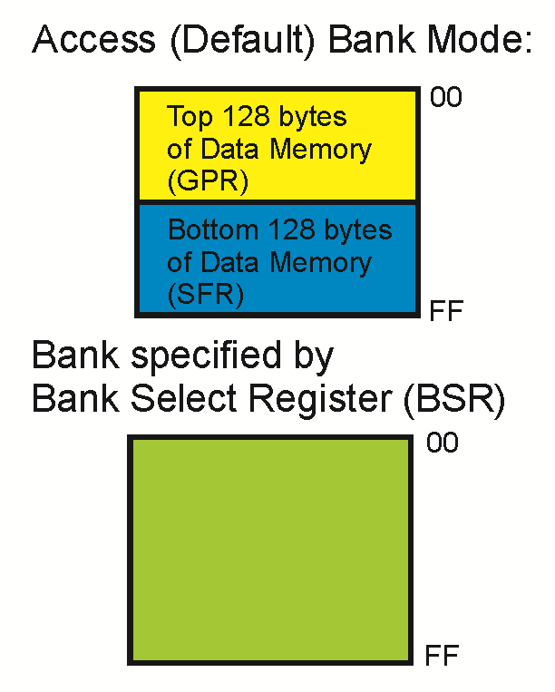
Data Memory in PIC18

Slide 11
Banks in Data Memory
Divided into 16 banks.
256 bytes per bank
Access (Default) Bank is a 256-byte bank consisting of:
128 bytes of GPRs located at 00H to 7FH in the access bank, mapped from 000H to 07FH of the data memory
128 bytes of SFRs located at 80H to FFH in the access bank, mapped from F80H to FFFH of the data memory
A program that requires more than the amount of RAM provided in the access bank necessitates bank switching.
PIC18 uses the bank concept because in many instructions there are 8 bits to indicate the RAM address (12 bits address)

Slide 12
General-purpose and Special-function registers
Two types of registers: general-purpose (GPR) and special-function registers (SFR)
GPRs provide storage for variables used in a program.
SFRs are used to control the operation of the CPU and peripherals.
The WREG register is involved in the execution of many instructions.
The STATUS register contains the arithmetic status of the ALU.

Slide 13
PIC18F Programming Model
The representation of the internal architecture of a microprocessor, necessary to write assembly language programs
Divided into two groups
Arithmetic Logic Unit (ALU) and Registers
From Microprocessor Unit (MPU)
Special Function Registers (SFRs)
From Data (File) Memory

Slide 14
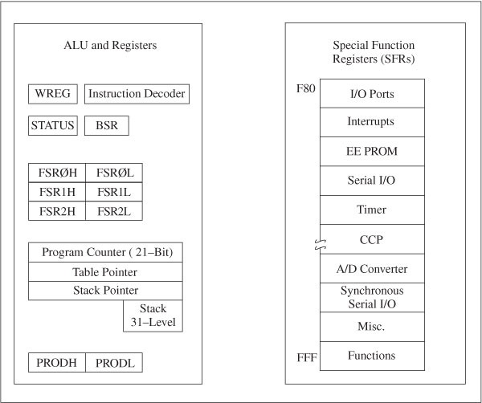
PIC18F Programming Model

Slide 15
Registers
Program Counter (PC)
21-bit register functions as a pointer to program memory during program execution
STATUS: Flag Register
5 individual bits called flags
WREG (W): Working Register
8-bit Accumulator
Product
16-bit Product of 8-bit by 8-bit Multiply

Slide 16
Registers
Table Pointer (access program ROM)
21-bit register used as a memory pointer to copy bytes between program memory and data registers
Stack Pointer (SP)
5-bit register used to point to the stack
Stack
31 registers used for temporary storage of memory addresses during execution of a program

Slide 17
Registers
(Access RAM area)
BSR: Bank Select Register (0 to F)
4-bit Register
Provides upper 4-bits of 12-bit address of data memory
FSR: File Select Registers
FSR0, FSR1, and FSR2
FSR: composed of two 8-bit registers
FSRH and FSRL
Used as pointers for data registers
Holds 12-bit address of data register

Slide 18
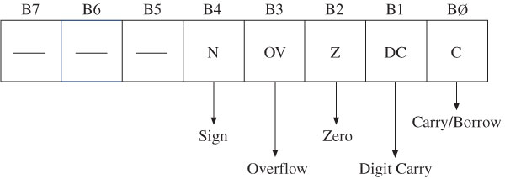
Flags in Status Register (check the state of W register )
N (Negative Flag)
Set when bit B7 is one as the result of an arithmetic/logic operation
OV (Overflow Flag)
Set when result of an operation of signed numbers goes beyond 7-bits
Z (Zero Flag)
Set when result of an operation is zero
DC (Digit Carry Flag) (Half Carry)
Set when carry generated from Bit3 to Bit4 in an arithmetic operation
C (Carry Flag)
Set when an addition generates a carry

Slide 19
Special Function Registers
SFRs:
Data registers associated with I/O ports, support devices, and processes of data transfer
I/O Ports (A to E)
Interrupts
EEPROM
Serial I/O
Timers
Capture/Compare/PWM (CCP)
Analog-to-Digital (A/D) Converter

Slide 20
Sections
2.1 Inside the PIC18
2.2 Simple PIC18 Program
2.3 Introduction to PIC18 Assembly Programming
2.4 Assembling and Running an PIC18 Program
2.5 The Program Counter and ROM Space in the PIC18
2.6 RISC Architecture in the PIC
2.7 PIC18 Flag Bits and the PSW Register
2.8 PIC18 Register Banks and Stack

Slide 21
Data Format Representation
Data can only be represented as a 8-bit number in PIC18
Four ways to represent a byte:
Hexadecimal (Default)
Binary
Decimal
ASCII

Slide 22
Hexadecimal Numbers
Four ways to show that hex representation is used:
Put nothing in front or back of the number: movlw 99. (Hex is the default representation)
Use h (or H) right after the number: movlw 99H
Put 0x (or 0X) before the number: movlw 0x99
Put h in front of the number, with single quotes around the number: movlw h ‘99’
If 1 or 2 is used and the starting hex digit is A-F, the number must be perceded by a 0.
e.g., movlw C6 is invalid. Must be movlw 0C6
Notes:
assembler knows hex is used

Slide 23
Binary and Decimal Numbers
The only way to represent a binary number is to put a B (or b) in front: movlw B ‘10011001’
Two ways to present a decimal number:
Put a D (or d) in front: movlw D ‘12’
Use the “.value” format: movlw .12
The only way to represent an ASCII character is to put a A (or a) in front: movlw A ‘2’.
The ASCII code 0x32 is used to represent the character ‘2’. 0x32 is stored in WREG.

Slide 24
PIC18 Instruction Set
Includes 77 instructions
73 one word (16-bit) long
4 two words (32-bit) long
Divided into seven groups
Move (Data Copy) and Load
Arithmetic
Logic
Program Redirection (Branch/Jump)
Bit Manipulation
Table Read/Write
Machine Control

Slide 25

The WREG register (accumulator)
Many registers for arithmetic and logic operation.
The WREG (WORking) Register is one of the widely used registers.
 8-bit register → any data larger than 8 bits must be broken into 8-bits chunks before it is processed.
 There is only one .

Slide 26
MOVLW
Moves 8-bit data into WREG
MOVLW k; move literal value k into WREG
Example
MOVLW 25H
MOVLW 0A5H
Is the following code correct?
􀂁 MOVLW 9H
􀂁 MOVLW A23H

Slide 27
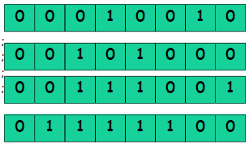
ADDLW (chapter2_1)
ADDLW k; Add literal value k to WREG (k +WREG)
Example: WREG
MOVLW 12H ;
ADDLW 16H ;
ADDLW 11H ;
ADDLW 43H ;

Slide 28
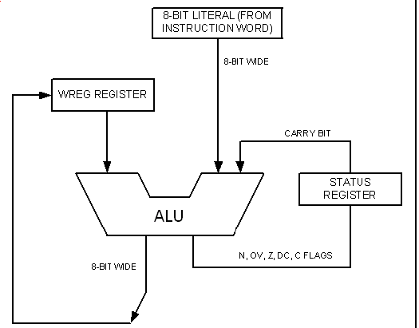
ADDLW

Slide 29
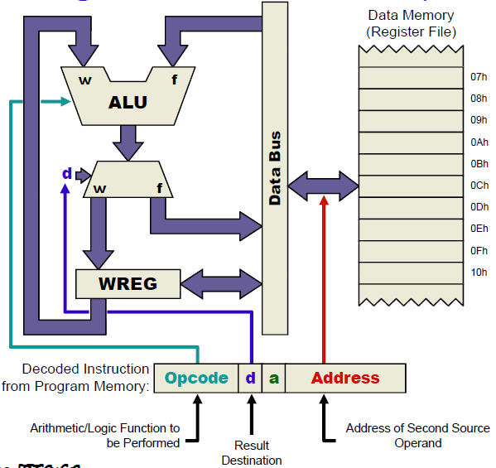
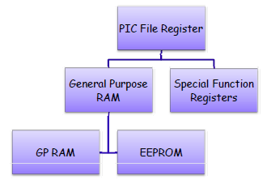
The PIC File register (data memory)
Used for data storage, scratch pad and registers for internal use and function
8-bit width

Slide 30
Special Function Registers
dedicated to specific functions such as ALU status, timers, serial communication, I/O ports, ADC,…
They are used for control of the microcontroller or peripheral
8-bit registers
Their numbers varies from one chip to another

Slide 31
General Purpose Registers
Group of RAM locations
8-bit registers
Larger than SFR
Difficult to manage them by using Assembly language
Easier to handle them by C Compiler.
GPRAM VS. EEPROM
EEPROM: an add-on memory (for holding data after power off), can be zero size

Slide 32
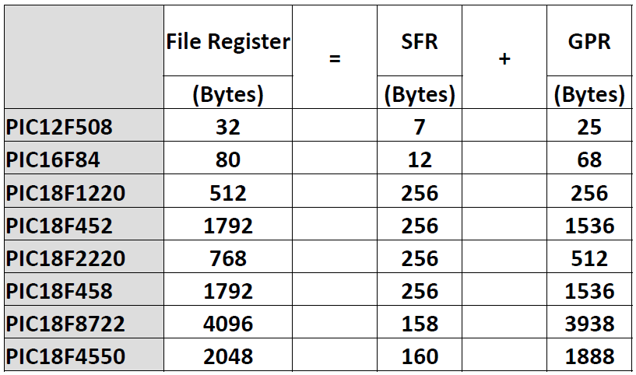
File Register Size

Slide 33
File Registers and access bank in the PIC18
The PIC18 Family can have a max. of 4096 Bytes for File Registers
The File Registers
has addresses of 000- FFFH
divided into a number of 256-byte banks
Max. 16 banks (How?)
At least there is one bank
Known as default access bank.
Bank switching is a method used to access all the banks

Slide 34
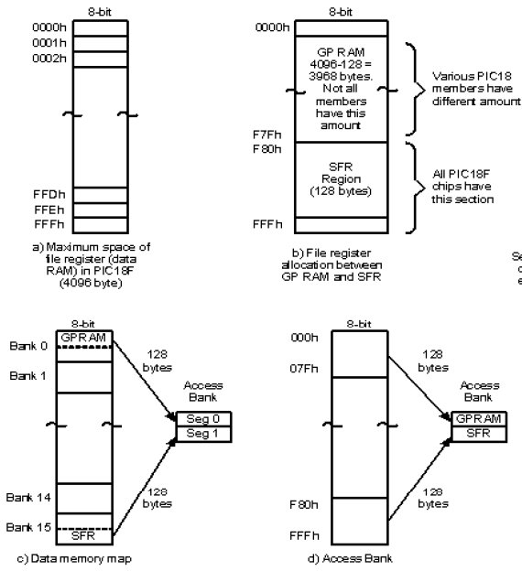
File Register and access bank in the PIC18

Slide 35
Access bank in the PIC18
It is 256-Byte bank.
Divided into equal two discontinuous sections (each 128 B).
GP RAM, from 0 to 7FH
SFR, from F80H to FFFH

Slide 36
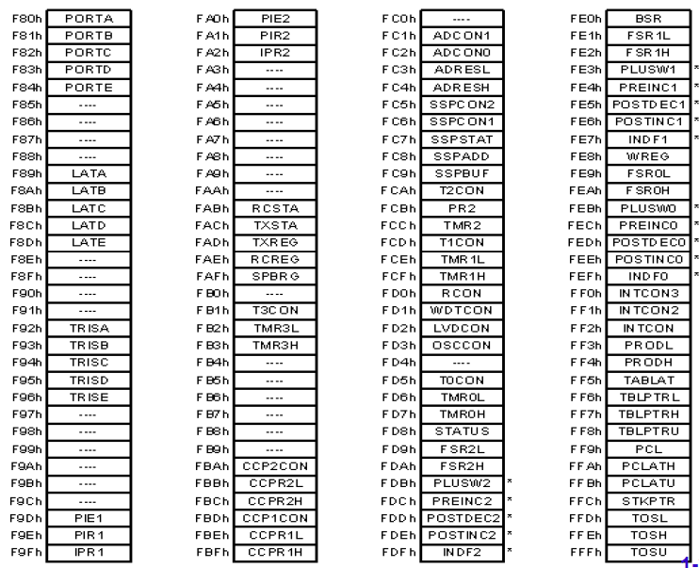
SFRs of the PIC18

Slide 37
Using instructions with the default access bank
Instructions to access other locations in the file register for ALU and other operations.
MOVWF
COMF
DECF
MOVF
MOVFF

Slide 38
MOVWF instruction
F indicates for a file register
MOVWF Address
It tells the CPU to copy the source register, WREG, to a destination in the file register.
A location in the SPR
A location in GP RAM

Slide 39
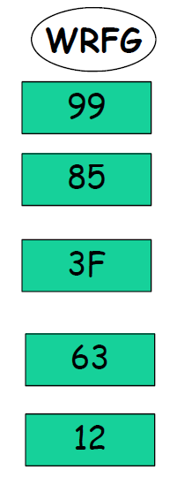
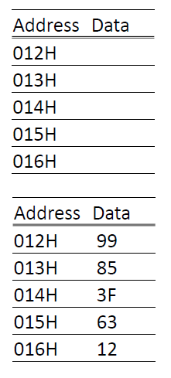
MOVWF instruction (chapter2_2)
Data Memory
MOVLW 99H
MOVWF 12H
MOVLW 85H
MOVWF 13H
MOVLW 3FH
MOVWF 14H
MOVLW 63H
MOVWF 15H
MOVLW 12H
MOVWF 16H
Note: We cannot move literal values directly into the
general purpose RAM location in the PIC18. They
must be moved there via WREG.

Slide 40
ADDWF instruction
Adds together the content of WREG and a file register location
ADDWF File Reg. Address, D
The result will be placed in either the WREG or in the file register location
D indicates the destination bit
If D=0 or (D=w)
The result will be placed in the WREG
If D=1 or (D=f)
The result will be placed in the file register

Slide 41
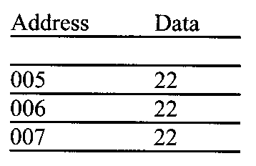
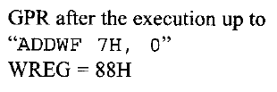
ADDWF (chapter2_3)
MOVLW 22H ;WREG=22H
MOVWF 5H ;copy WREG contents to location 5H
MOVWF 6H ;copy WREG contents to location 6H
MOVWF 7H ;copy WREG contents to location 7H
ADDWF 5H, 0 ;add W and loc 5, put result in WREG
; WREG=44H
ADDWF 6H, 0 ;add W and loc 6, put result in WREG
; WREG=66H
ADDWF 7H, 0 ;add W and loc 7, put result in WREG
; WREG=88H

Slide 42
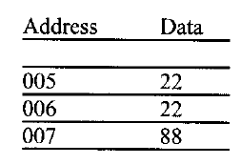

ADDWF
MOVLW 22H ;WREG=22H
MOVWF 5H ;copy WREG contents to location 5H
MOVWF 6H ;copy WREG contents to location 6H
MOVWF 7H ;copy WREG contents to location 7H
ADDWF 5H, 0 ;add W and loc 5, put result in WREG
; WREG=44H
ADDWF 6H, 0 ;add W and loc 6, put result in WREG
; WREG=66H
ADDWF 7H, 1 ;add W and loc 7, put result in
;loc 7, content of loc 07 = 88H,
;WREG=66.

Slide 43
COMF instruction
COMF File Reg. Address, D
It tells the CPU to complement the content of fileReg and places the results in WREG or in fileReg.
D indicates the destination bit
If D=0 or (D=w)
The result will be placed in the WREG
If D=1 or (D=f)
The result will be placed in the file register

Slide 44
COMF (chapter2_4)
Write a simple program to toggle the SFR of Port B continuously forever.
Solution:
MOVLW 55H
MOVWF PORTB
B1: COMF PORTB,F
GOTO B1

Slide 45
DECF (INCF) instruction (chapter2_5)
` DECF File Reg. Address, D
It tells the CPU to decrement the content of fileReg and places the results in WREG or in fileReg.
MOVLW 3 ;WREG=3
MOVWF 20H ;20H=(3)
DECF 20H, F ;WREG=3, 20H=(2)
DECF 20H, F ;WREG=3, 20H=(1)
DECF 20H, F ;WREG=3, 20H=(0)

Slide 46
DECF instruction (chapter2_5)
`
MOVLW 3 ;WREG=3
MOVWF 20H ;20H=(3)
DECF 20H, W ;WREG=2, 20H=(3)
DECF 20H, W ;WREG=2, 20H=(3)
DECF 20H, W ;WREG=2, 20H=(3)

Slide 47
MOVF instruction
MOVF File Reg. Address, D
It is intended to move content of a File Reg. to WREG.
If D=0
copies the content of fileReg (from I/O pin) to
WREG
If D=1
The content of the fileReg is copied to itself.
(why?)

Slide 48
MOVF (chapter2_6 open workbook))
Write a simple program to get data from the SFRs of Port B and send it the SFRs of PORT C continuously.
Solution:
Again: MOVF PORTB, W
MOVWF PORTC
GOTO Again

Slide 49
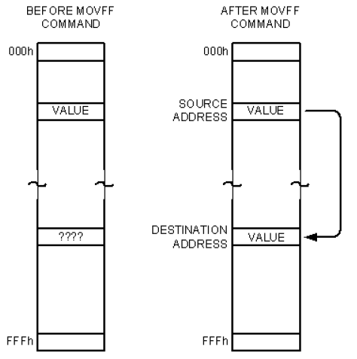
MOVFF instruction
Copy the content of one location in FileReg to another location in FileReg.
MOVFF Source FileReg, destination FileReg

Slide 50
MOVFF
Write a simple program to get data from the SFRs of Port B and send it the SFRs of PORT C continuously.
Solution:
Again: MOVFF PORTB, PORTC
GOTO Again

Slide 51
Sections
2.1 Inside the PIC18
2.2 Simple PIC18 Program
2.3 Introduction to PIC18 Assembly Programming
2.4 Assembling and Running an PIC18 Program
2.5 The Program Counter and ROM Space in the PIC18
2.6 RISC Architecture in the PIC
2.7 PIC18 Flag Bits and the PSW Register
2.8 PIC18 Register Banks and Stack

Slide 52
Program Languages
Machine language：
a program that consists of 0s and 1’s.
CPU can work on machine language directly.
Example ：7D25
Low-level language：
It deals directly with the internal structure of the CPU.
Programmers must know all details of the CPU.
Example ：MOVFF 20H, 21H
High-level language：
Machine independent
Example ：a=37;（C++）

Slide 53
Assembly Language
Assembly languages were developed which provided mnemonics for the machine code instructions, plus other features.
Mnemonic：the instruction
Example：MOVFF, MOVLW
Provide decimal number, named registers, label, command
programming faster and less prone to error.
Assembly language programs must be translated into machine code by a program called an assembler.

Slide 54
Assembler
Assembler：
a software program can translate an Assembly language program into machine code.
Source program
Object program, opcode, object code
Source Program
Text file
Object Program
Text file
Assembler

Slide 55
Structure of Assembly Language
An Assembly language program (see Program 2-1) is a series of statements.
[label:] mnemonic [operands] [;command]
Brackets indicate that a field is optional.
Label is the name to refer to a line of program code. An label referring to an instruction must be followed by a common “:”.
Here: GOTO Here
Mnemonic and operand(s) perform the real work of the program.
The comment field begins with a semicolon “;”.
Notes:
pseudo instruction is called directives, too.

Slide 56
Mnemonic ＆ Pseudo Instruction
Two types of assembly instructions：
Mnemonic：tell the CPU what to do
Example：MOVFF, ADDLW (opcodes)
pseudo-instruction：give directions to the assembler
Example：ORG 0H, END
pseudo instruction is called directives, too.

Slide 57
ORG ＆ END
ORG tells the assembler to place the opcode at ROM with a chosen start address.
ORG start-address
ORG 0200H ;put the following codes
;start at location 200H
END indicates to the assembler the end of the source code.
END
END ;end of asm source file

Slide 58
EQU and SET Directives
EQU – associates a constant number with an address label.
e.g., COUNT equ 0x25
..........
movlw COUNT; WREG = 0x25
SET – identical to EQU, but value assigned by SET can be reassigned later.
e.g., COUNT set 0x00
...........
COUNT set 0x25
..........
movlw COUNT; WREG = 0x25

Slide 59
EQU and SET Directives
e.g., Move 22H into two file registers with addresses 0x05 and 0x06, add the contents of all three registers and put the result in WREG:
Without EQU
movlw 0x22
movwf 0x05
movwf 0x06
addwf 0x05, W
addwf 0x06, W
With EQU
FirstReg EQU 0x05
SecReg EQU 0x06
movlw 0x22
movwf FirstReg
movwf SecReg
addwf FirstReg, W
addwf SecReg, W

Slide 60
CBLOCK Directive (clock and clock.asm)
Defines a list of named constants.
Format: cblock <num>
<constant label> [:<inc>]
endc
If
e.g. 1, cblock 0x50
test1, test2, test3, test4
endc
Values Assigned:
test1 = 0x50, test2 = 0x51,
test3 = 0x52, test4 = 0x53.

Slide 61
CBLOCK Directive
e.g. 2,
cblock 0x30
twoBytesValue: 0, twoByteHi, twoByteLo
queue: d‘40’
queuehead, queuetail
double1: 2, double2: 2
endc
Value Assigned:
twoBytesValue = 0x30, twoByteHi = 0x30
twoByteLo = 0x31, queue = 0x32
queuehead = 0x5A, queuetail = 0x5B
double1 = 0x5C, double2 = 0x5E

Slide 62
Sample of an Assembly Language Program
LIST P=18F4520 ;directive to define processor
#include <P18F4520.INC> ;CPU specific variable ;definitions
SUM: EQU 10H ;RAM loc 10H fro SUM
ORG 0H; start at address 0
MOVLW 25H ; WREG = 25
ADDLW 0x34 ;add 34H to WREG=59H
ADDLW 11H ;add 11H to WREG=6AH
ADDLW d'18' ; W = W+12H=7CH
ADDLW 1CH ; W = W+1CH=98H
ADDLW b'00000110' ; W = W+6H=9EH
MOVWF SUM ;save the result in SUM location
HERE: GOTO HERE ;stay here forever
END ; end of asm source file

Slide 63
Sections
2.1 Inside the PIC18
2.2 Simple PIC18 Program
2.3 Introduction to PIC18 Assembly Programming
2.4 Assembling and Running an PIC18 Program
2.5 The Program Counter and ROM Space in the PIC18
2.6 RISC Architecture in the PIC
2.7 PIC18 Flag Bits and the PSW Register
2.8 PIC18 Register Banks and Stack

Slide 64
Steps to Create an Executable Assembly Language Program (hello and mytest)
Execute the MAPLAB IDE program.
Click “File”; “New” and type the code into the file editor window.
Click “File”, “Save As”. Create and Select the “C:\Code\Expt1” folder and type “prog0.asm’ as the program file name. (Make sure you save the file into the Expt1 folder).
Click “Project”, “Project Wizard…”, “Next >”, select device “PIC18F4520”, click “Next >”, select “Microchip MPASM Toolsuite”, click “Next >”
Browse into “C:\Code\Expt1” folder, type “Expt1” as the Project file name and click “Save”.
Click “Next >”, expand the folder tree and locate the file prog0.asm. Click “Add >>” and “Next >” to put the prog0.asm file to the Project. Check the project parameters list and click “Finish” to finish the project definition process.

Slide 65
Steps to Create an Executable Assembly Language Program
Click “Project”, “Build All” and select “Absolute”.
“BUILD SUCCESSED” should appear at Output window. Should “BUILD FAILED” appear instead, check for the error messages, fix any errors found and repeat the build process 7 until success.
Click “File”, “Save Workspace” to save your work. It will save all your current project related parameters into the file with extension “mcw”. You can double click file Expt1.mcw later to continue your development.
Now we can use choose Debugger (such as MPLAB SIM or PICKIT 3)
to test our program.

Slide 66
Sample of an Assembly Language Program
LIST P=18F4520 ;directive to define processor
#include <P18F4520.INC> ;CPU specific variable ;definitions
SUM: EQU 10H ;RAM loc 10H fro SUM
ORG 0H; start at address 0
MOVLW 25H ; WREG = 25
ADDLW 0x34 ;add 34H to WREG=59H
ADDLW 11H ;add 11H to WREG=6AH
ADDLW d'18' ; W = W+12H=7CH
ADDLW 1CH ; W = W+1CH=98H
ADDLW b'00000110' ; W = W+6H=9EH
MOVWF SUM ;save the result in SUM location
HERE: GOTO HERE ;stay here forever
END ; end of asm source file

Slide 67
Notes: listing file using MPLAB to check
Memory Content
The Change in Program Count
67
Notes:
67

Slide 68
LOC OBJECT CODE LINE SOURCE TEXT
VALUE
00001 LIST P=18F4520 ;directive to define processor
00002 #include <P18F4520.INC> ;
0000010 00004 SUM: EQU 10H ;RAM loc 10H fro SUM
000000 00005 ORG 0H; start at address 0
000000 0E25 00006 MOVLW 25H ; WREG = 25
000002 0F34 00007 ADDLW 0x34 ;add 34H to WREG=59H
000004 0F11 00008 ADDLW 11H ;add 11H to WREG=6AH
000006 0F12 00009 ADDLW d'18' ; W = W+12H=7CH
000008 0F1C 00010 ADDLW 1CH ; W = W+1CH=98H
00000A 0F06 00011 ADDLW b'00000110' ; W = W+6H=9EH
00000C 6E10 00012 MOVWF SUM ;save the result in SUM location
00000E EF07 F000 00013 HERE: GOTO HERE ;stay here forever
00014 END ; end of asm source file
Notes:
The content discuss later

Slide 69
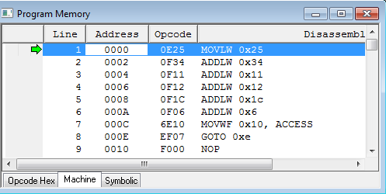
Program Memory

Slide 70
Sections
2.1 Inside the PIC18
2.2 Simple PIC18 Program
2.3 Introduction to PIC18 Assembly Programming
2.4 Assembling and Running an PIC18 Program
2.5 The Program Counter and ROM Space in the PIC18
2.6 RISC Architecture in the PIC
2.7 PIC18 Flag Bits and the PSW Register
2.8 PIC18 Register Banks and Stack

Slide 71
The Program Counter and Program ROM Space in the PIC
Program Counter (PC) is used by the CPU to point to the address of the next instruction to be executed
The wider the program counter, more the memory locations can be accessed
PIC16 has 14 bits (8K)
PIC18 has 21 bits (2M)
8051 has 16 bits (64K)

Slide 72
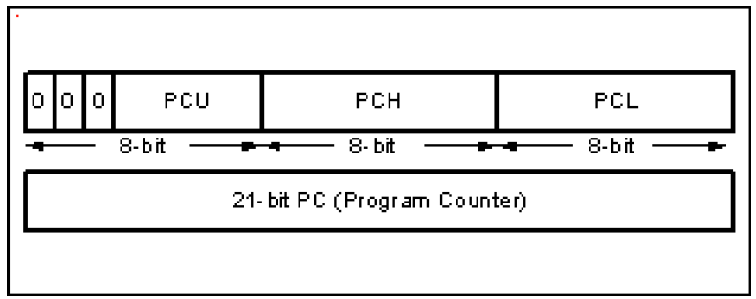
PIC18 PC
Notes:
Notices:
1. Each label name must be unique.
2. Special characters ? @ . _ : $ can’t used in label.
3. The first character of the label must be an alphabetic character. (不可是數字)
4. Keywords can’t be used as labels.
5. Check your assembler since there exists their rules.

Slide 73
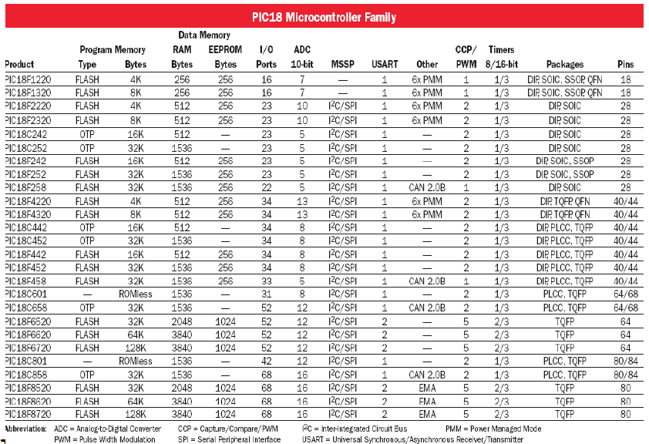
PIC family
Notes:
Look Appendix F and ask students to check the values.

Slide 74
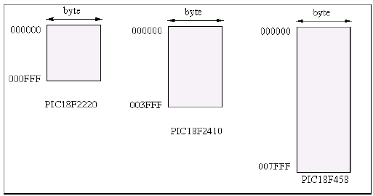
ROM Size
Find the ROM Memory Address of each of
the following PIC chips:
a) PIC18F2220
b) PIC18F2410
c) PIC18F458
Notes:
Ask why need #?
Notice that MOV A, #23H means A=23H
MOV A,23H means read RAM with address 23H to A.
Since we want to put the value of DATA1 to DPTR, so # is necessary.

Slide 75
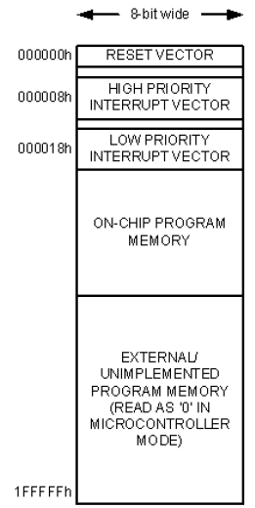
Place Code in
At what address does the Powering UP CPU wake up when power applied?
The uC wakes up at memory address 0000
The PC has the value 0000
ORG directive put the address of the first op code at the memory location 0000
75
Notes:
75
Ask why need #?
Notice that MOV A, #23H means A=23H
MOV A,23H means read RAM with address 23H to A.
Since we want to put the value of DATA1 to DPTR, so # is necessary.

Slide 76
Place Code in ROM
LOC OBJECT CODE LINE SOURCE TEXT
VALUE
00001 LIST P=18F4520 ;directive to define processor
00002 #include <P18F4520.INC> ;
0000010 00004 SUM: EQU 10H ;RAM loc 10H fro SUM
000000 00005 ORG 0H; start at address 0
000000 0E25 00006 MOVLW 25H ; WREG = 25
000002 0F34 00007 ADDLW 0x34 ;add 34H to WREG=59H
000004 0F11 00008 ADDLW 11H ;add 11H to WREG=6AH
000006 0F12 00009 ADDLW d'18' ; W = W+12H=7CH
000008 0F1C 00010 ADDLW 1CH ; W = W+1CH=98H
00000A 0F06 00011 ADDLW b'00000110' ; W = W+6H=9EH
00000C 6E10 00012 MOVWF SUM ;save the result in SUM location
00000E EF07 F000 00013 HERE: GOTO HERE ;stay here forever
00014 END ; end of asm source file
76
Notes:
76
Ask why need #?
Notice that MOV A, #23H means A=23H
MOV A,23H means read RAM with address 23H to A.
Since we want to put the value of DATA1 to DPTR, so # is necessary.

Slide 77
Place Code in ROM
If we change ORG 0H to ORG 20H, we have
LOC OBJECT CODE LINE SOURCE TEXT
VALUE
00000010 00004 SUM: EQU 10H ;RAM loc 10H fro SUM
000000 00005 ORG 00H; start at address 0
000000 EF10 F000 00006 GOTO Main
000020 00007 Main: ORG 20H
000020 0E25 00008 MOVLW 25H ; WREG = 25
000022 0F34 00009 ADDLW 0x34 ;add 34H to WREG=59H
000024 0F11 00010 ADDLW 11H ;add 11H to WREG=6AH
000026 0F12 00011 ADDLW d'18' ; W = W+12H=7CH
000028 0F1C 00012 ADDLW 1CH ; W = W+1CH=98H
00002A 0F06 00013 ADDLW b'00000110' ; W = W+6H=9EH
00002C 6E10 00014 MOVWF SUM ;save the result in SUM location
00002E EF17 F000 00015 HERE: GOTO HERE ;stay here forever
00016 END ; end of asm source file
77
Notes:
77
Ask why need #?
Notice that MOV A, #23H means A=23H
MOV A,23H means read RAM with address 23H to A.
Since we want to put the value of DATA1 to DPTR, so # is necessary.

Slide 78
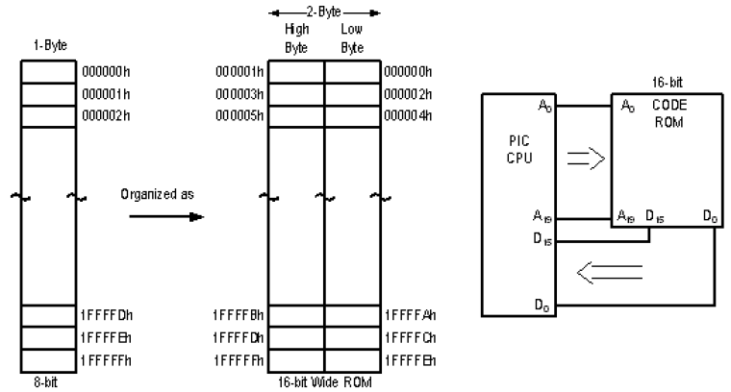
Program ROM width
Byte addressable: each location holds only one byte
CPU with 8-Bit will fetch one byte a time
Increasing the data bus will bring more information
Solution: Data bus between CPU and ROM can be similar to traffic lanes on the highway
The wide of Data path is 16 bit
Increase the processing power
Match the PIC18 instruction single cycle
78
Notes:
78
Ask why need #?
Notice that MOV A, #23H means A=23H
MOV A,23H means read RAM with address 23H to A.
Since we want to put the value of DATA1 to DPTR, so # is necessary.

Slide 79
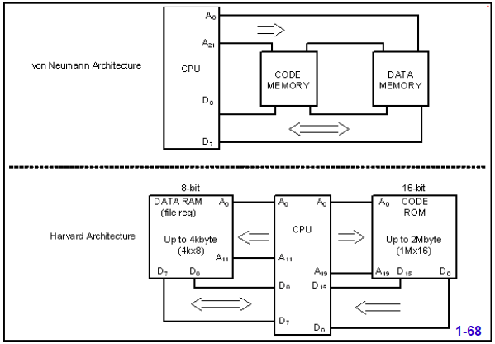
Review: von Neumann vs. Harvard Architecture
79
Notes:
79
Ask why need #?
Notice that MOV A, #23H means A=23H
MOV A,23H means read RAM with address 23H to A.
Since we want to put the value of DATA1 to DPTR, so # is necessary.

Slide 80
Instruction size of the PIC18
PIC Instructions are 2-Byte or 4-Byte
The first seven or eight bits represents the op-code
Most of PIC18 instructions are 2-Byte
MOVLW 0000 1110 kkkk kkkk (0E XX)
ADDLW 0000 1111 kkkk kkkk (0F XX)
MOVWF 0110 111a ffff ffff (6E XX)
or (6F XX)
• A specifies the default access bank if it is 0 and if a
= 1 we have to use bank switching
80
Notes:
80
Ask why need #?
Notice that MOV A, #23H means A=23H
MOV A,23H means read RAM with address 23H to A.
Since we want to put the value of DATA1 to DPTR, so # is necessary.

Slide 81
Instruction size of the PIC18
4-Byte instructions include
MOVFF (move data within RAM, which is 4k)
1100 ssss ssss ssss (0≤ fs ≤ FFF)
1111 dddd dddd dddd (0≤ fd ≤ FFF)
GOTO (the code address bus width is 21, which
is 2M)
1110 1111 k₇kkk kkkk₀
1111 k₁₉kkk kkkk kkkk₈
81
Notes:
81
Ask why need #?
Notice that MOV A, #23H means A=23H
MOV A,23H means read RAM with address 23H to A.
Since we want to put the value of DATA1 to DPTR, so # is necessary.

Slide 82
Sections
2.1 Inside the PIC18
2.2 Simple PIC18 Program
2.3 Introduction to PIC18 Assembly Programming
2.4 Assembling and Running an PIC18 Program
2.5 The Program Counter and ROM Space in the PIC18
2.6 RISC Architecture in the PIC
2.7 PIC18 Flag Bits and the PSW Register
2.8 PIC18 Register Banks and Stack

Slide 83
RISC Architecture in the PIC
To increase the processing power of the CPU
Increase the clock frequency of the chip
Use Harvard architecture
Change the internal architecture of the CPU and use what is called RISC architecture
Notes:
Arithmetic Example：ADD, SUB, MUL, DIV

Slide 84
RISC Architecture in the PIC
RISC | CISC
Simple Instruction with regular structure | Complex instructions with irregular strcuture
Execute one instruction in one cycle | Different instructions with different execution time
pipeline | May also pipeline
Many CPU registers | Smaller number of CPU registers
Separated data and program memory | One memory space
Most operations are registers to registers | Most operations can be register to memory
Notes:
Arithmetic Example：ADD, SUB, MUL, DIV

Slide 85
Sections
2.1 Inside the PIC18
2.2 Simple PIC18 Program
2.3 Introduction to PIC18 Assembly Programming
2.4 Assembling and Running an PIC18 Program
2.5 The Program Counter and ROM Space in the PIC18
2.6 RISC Architecture in the PIC
2.7 PIC18 Flag Bits and the PSW Register
2.8 PIC18 Register Banks and Stack

Slide 86
PIC Flags
When the CPU performs operations, sometimes an exception may occur.
Example：overflow
How does the CPU tells control units that an exception occurs?
Answer is the flags.
C Carry Flag.
DC Digital Carrry Flag
Z Zero Flag
OV Overflow Flag
N Negative Flag
Notes:
Arithmetic Example：ADD, SUB, MUL, DIV

Slide 87
Flags in Status Register
N (Negative Flag)
Set when bit B7 is one as the result of an arithmetic/logic operation
OV (Overflow Flag)
Set when result of an operation of signed numbers goes beyond 7-bits
Z (Zero Flag)
Set when result of an operation is zero
DC (Digit Carry Flag) (Half Carry)
Set when carry generated from Bit3 to Bit4 in an arithmetic operation
C (Carry Flag)
Set when an addition generates a carry

Slide 88
Effect of addlw on the status register (flag and flag.asm)
e.g. 1:
MOVLW 0x38
ADDLW 0x2F
N = 0 ; bit7=0
OV=0 ; +ve + +ve = + ve => no overflow (in signed sense)
Z=0 ; NOT all Zeros
DC=1 ; A carry from the first and second nibble
C=0 ; No carry
38h
+ 2Fh
67h

Slide 89
Effect of addlw on the status register
e.g. 2:
MOVLW 0x9C
ADDLW 0x64
N = 0 ; bit7=0
OV=0 ; -ve + +ve = + ve => no overflow (in signed sense)
Z=1 ; All zeros
DC=1 ; A carry from the first and second nibble
C=1 ; A carry is generated. (in unsigned sense)
9Ch
+ 64h
00h

Slide 90
Effect of addlw on the status register
e.g. 3:
MOVLW 0x80
ADDLW 0x81
N = 0 ; bit7=0
OV=1 ; -ve + -ve = + ve => overflow (in signed sense)
Z=0 ; All zeros
DC=0 ; A carry from the first and second nibble
C=1 ; A carry is generated (in unsigned sense)
80h (in signed sense -128)
+ 81h (in signal sense -127)
01h

Slide 91
Effect of addlw on the status register
e.g. 4:
MOVLW 0x7F
ADDLW 0x7F
N = 1 ; bit7=1
OV=1 ; +ve + +ve = -ve => overflow (in signed sense)
Z=0 ; All zeros
DC=1; A carry from the first and second nibble
C=0 ; A carry is not generated (in unsigned sense)
7Fh
+ 7Fh
Feh

Slide 92
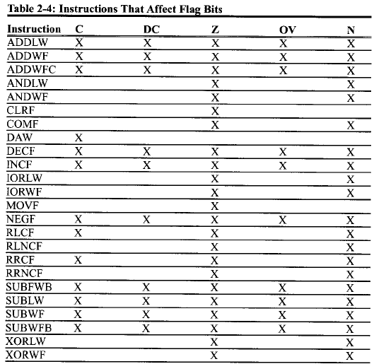
Instruction That Affect Flag Bits

Slide 93
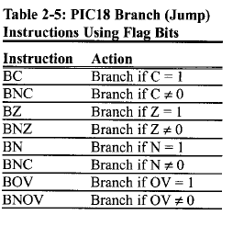
Flag Bits and Decision Making
Status flags are also called conditions, there
are instructions that will make a conditional
Jump (branch) based on the status of the flag
We will discuss them later.

Slide 94
Sections
2.1 Inside the PIC18
2.2 Simple PIC18 Program
2.3 Introduction to PIC18 Assembly Programming
2.4 Assembling and Running an PIC18 Program
2.5 The Program Counter and ROM Space in the PIC18
2.6 RISC Architecture in the PIC
2.7 PIC18 Flag Bits and the PSW Register
2.8 PIC18 Register Banks and Stack

Slide 95
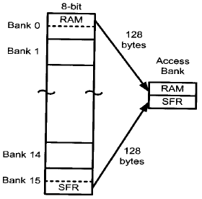
Register Banks
So far, we only consider the access bank in data memory. Actually, we can choose other banks
INCF MYREG, D, A
MOVWF MYREG, A
A=0, the access bank
A=1, other bank
To use this feature,
Load BSR with the desired bank number
Make A=1 in the instruction

Slide 96
Register Banks (other_bank)
Example:
MYREG EQU 0x40 ;define a location
MOVLB 0x2
MOVLW 0xFF ; WREG=0
MOVWF MYREG, 1 ; loc (240)=0, WREG=0,
INCF MYREG,F,1; loc (240)=1, WREG=0,
INCF MYREG,F,1; loc (240)=2, WREG=0,
INCF MYREG,F,1; loc (240)=3, WREG=0,

Slide 97
Register Banks (default bank)
Example:
MYREG EQU 0x40 ;define a location
MOVLB 0x2
MOVLW 0xFF ; WREG=0
MOVWF MYREG ; loc (40)=0, WREG=0,
INCF MYREG,F ; loc (40)=1, WREG=0,
INCF MYREG,F ; loc (40)=2, WREG=0,
INCF MYREG,F ; loc (40)=3, WREG=0,

Slide 98
Stack
Temporary memory storage space used during the execution of a program
Can be part of R/W memory or specially designed group of registers
Stack Pointer (SP)
The MPU uses a register called the stack pointer, similar to the program counter (PC), to keep track of available stack locations.

Slide 99
Stack
Stack：a section of RAM to store data items
Two operations on the stack：
PUSH：put an item onto the top of the stack
POP：remove an item from the top of the stack
PUSH
PUSH
PUSH
POP
POP

Slide 100
PIC18 Microcontroller Stack
Hardware Stack
31 registers
21-bits wide
Not part of program memory or data registers
Stack Pointer (STKPTR)
5-bit address
Top of the Stack (TOS)
Pointed to by the stack pointer
Copied into three special function registers
TOSU (Upper), TOSH (High), and TOSL (Low)

Slide 101
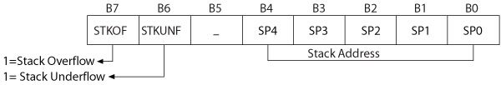
STKPTR Register
SP4-SP0: Stack Address
STKOF: Stack overflow
When the user attempts to use more than 31 registers to store information (data bytes) on the stack
STKUNF: Stack underflow
When the user attempts to retrieve more information than what is stored previously on the stack

Slide 102
Stack Instructions
PUSH
Increment the memory address in the stack pointer and store the contents of the program counter (PC+2) on the top of the stack
POP
Discard the address of the top of the stack and decrement the stack pointer by one

Slide 103
Subroutine
A group of instructions that performs a specified task
Written independent of a main program
Can be called multiple times to perform task by main program or by another subroutine
Call and Return instructions used to call a subroutine and return from the subroutine

Slide 104
Subroutine (stack and stack.asm)
LIST P=18F4520 ;directive to define processor
#include <P18F4520.INC> ;CPU specific variable definitions
ORG 0
GOTO Main
Main: ORG 20H ; start at address 0
MOVLW 25H ; WREG = 25
CALL sub1
MOVLW 20H
CALL sub1
HERE: GOTO HERE ;stay here forever
sub1: nop ; a subroutine
nop
MOVLW 0H
Return
END ; end of asm source file

Slide 105
Call and Return Instructions
CALL Label, s ;Call subroutine at Label
CALL Label, FAST ;FAST equivalent to s = 1
If s = 0: Increment the stack pointer and store the return address (PC+4) on the top of the stack (TOS) and branch to the subroutine address located at Label
If s = 1: Also copy the contents of W, STATUS, and BSR registers in their respective shadow registers
RCALL, n ;Relative call to subroutine
Increment the stack pointer and store the return address (PC+2) on the top of the stack (TOS) and branch to the location Label within = -2048 to + 2046

Slide 106
Call and Return Instructions
RETURN, s ;Return from subroutine
RETURN FAST :FAST equivalent to s = 1
If s = 0: Get the return address from the stack (TOS) and place it in PC and decrement the stack pointer
If s = 1: Also retrieve the contents of W, STATUS, and BSR registers from their shadow registers
RETLW 8-bit ;Return literal to WREG
Get the return address from the stack (TOS) and place it in PC and decrement the stack pointer
Return 8-bit literal to WREG

Slide 107
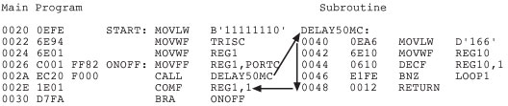
Program Listing with Memory Addresses
In the above example, the return address is 002E.

Slide 108
Demo
ROM Code Line No.
address
000000 00003 ORG 0
000000 EF10 F000 00004 GOTO Main
000020 00005 Main: ORG 20H; start at address 0
000020 0E25 00006 MOVLW 25H ; WREG = 25
000022 EC18 F000 00007 CALL sub1
000026 0E20 00008 MOVLW 20H
000028 EC18 F000 00009 CALL sub1
00002C EF16 F000 00010 HERE: GOTO HERE ;stay here forever
000030 0000 00011 sub1: nop ; a subroutine
000032 0000 00012 nop
000034 0E00 00013 MOVLW 0H
000036 0012 00014 Return
00015 END ; end of asm source file

Slide 109
Demo 2 (stack_2_level)
ORG 0
GOTO Main
Main: ORG 20H ; start at address 0
MOVLW 25H ; WREG = 25
CALL sub1
MOVLW 20H
CALL sub1
HERE: GOTO HERE ;stay here forever
sub1: nop ; a subroutine
call sub2
MOVLW 0H
Return
sub2: nop ; a subroutine
nop
MOVLW 1aH
Return
END ; end of asm source file

Slide 110
Demo 2 (stack_2_level)
000000 00003 ORG 0
000000 EF10 F000 00004 GOTO Main
00005
000020 00006 Main: ORG 20H ; start at address 0
000020 0E25 00007 MOVLW 25H ; WREG = 25
000022 EC18 F000 00008 CALL sub1
000026 0E20 00009 MOVLW 20H
000028 EC18 F000 00010 CALL sub1
00002C EF16 F000 00011 HERE: GOTO HERE ;stay here forever
00012
000030 0000 00013 sub1: nop ; a subroutine
000032 EC1D F000 00014 call sub2
000036 0E00 00015 MOVLW 0H
000038 0012 00016 Return
00017
00003A 0000 00018 sub2: nop ; a subroutine
00003C 0000 00019 nop
00003E 0E1A 00020 MOVLW 1aH
000040 0012 00021 Return

